Slide 1

C# Advanced
Course Introduction
SoftUni Team
Technical Trainers
Software University
https://softuni.bg/

Slide 2
Table of Contents
Course Objectives
Training and Team
Course Organization
Course Infrastructure
Evaluation Criteria

Slide 3
Have a Question?
sli.do
#csharp-advanced

Slide 4










SoftUni Diamond Partners

Slide 5



Educational Partners

Slide 6

Course Objectives

Slide 7
C# Advanced Module Goals
Working with linear data structures
Getting familiar with streams and files
Creating custom data structures
Building class hierarchies
Working with Exceptions
Applying principles and good practices for building quality software
Testing application correctness
7

Slide 8
C# Advanced Course Goals
Working with linear data structures
Stacks, Queues and Multidimensional Arrays
Getting familiar with streams and files
Creating custom data structures
List, Stack and LinkedList
Simple algorithms
Recursion, Sorting and Searching
8

Slide 9
Practical Programming Exam
3 practical problems for 4 hours
The first two problems may include:
Stacks and Queues
Multidimensional Arrays
Dictionaries
Defining Classes
Automated judge system
http://judge.softuni.bg
Solutions are evaluated for correctness only
Code quality is still not measured
9

Slide 10
Theoretical Exam
You will have 30 minutes once you enter
Multiple-choice with 1 or more correct answers
English
Automated quiz system
Available during the practical exam and 30 minutes after it
You can submit your answers just one time
Advice: Start it when you finish the practical exam
10

Slide 11

The Team

Slide 12
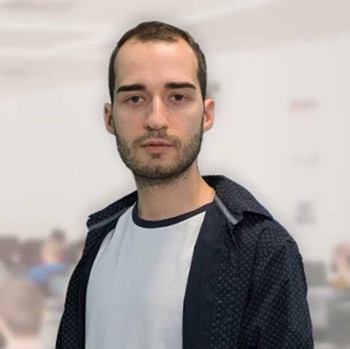
Nikolay Kostov
Solutions Architect @ ZenCodeo
15+ years in the IT
Developer, Manager, Trainer, Architect
Аctive role in the development of the Judge platform - https://judge.softuni.bg/
Microsoft Certified Trainer
Expert witness @ Bulgarian Court
Personal blog: nikolay.it

Slide 13
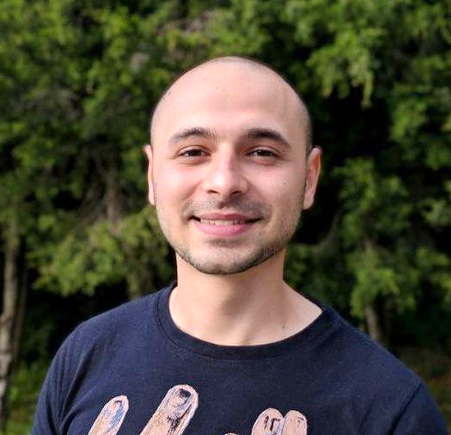
Stoyan Shopov
.NET Software Engineer
CoBuilder – Digitalization of Construction Industry
Technical Trainer @ SoftUni
3 years experience

Slide 14

Course Organization

Slide 15
C# Advanced Module – Timeline
14-Sep-2021
23-Oct-2021
16-Dec-2021
C# Advanced
6 weeks * 4 times / week
12 credits
Start: 14-Sep-2021
Theoretical Exam: 23-Oct-2021
Practical Exam: 23-Oct-2021
Theoretical Exam Retake: 16-Dec-2021
Practical Exam Retake: 16-Dec-2021

Slide 16

Homework Assignments & Exercises
Your homework is mainly work in class
Lesson days → slides + live demos + exercises
Exercise days → only exercises
How to submit your homework?
Submitted in the judge system
Do your homework when it's due
Assignments pile up quickly

Slide 17


SoftUni Certificate
Practical Exam 100%
Homework 5%
Evaluation
17

Slide 18
CPE Certificate
Practical Exam
Theoretical Exam
Evaluation
18

Slide 19



Course Web Site, Forum and FB Group
Official web site:
Official discussion forum:
Official Facebook group:
Community Facebook group:
https://softuni.bg/trainings/3483/csharp-advanced-september-2021
https://softuni.bg/forum/categories/30/
hhttps://www.facebook.com/groups/CsharpAdvancedSeptember2021
https://www.facebook.com/SoftUniCSharpCommunity/

Slide 20


The Free C# Fundamentals Textbook
The official textbook for the course
"Fundamentals of Computer Programming with C#", by Svetlin Nakov & Co., 2013, ISBN 9789544007737
English and Bulgarian versions (as PDF, ePub, …)
Freely downloadable from: www.introprogramming.info
The C# Programming courses @SoftUni.bg partially follows the book

Slide 21
Questions?
Notes:
21

Slide 22
Trainings @ Software University (SoftUni)
Software University – High-Quality Education, Profession and Job for Software Developers
softuni.bg, about.softuni.bg
Software University Foundation
softuni.foundation
Software University @ Facebook
facebook.com/SoftwareUniversity
Software University Forums
forum.softuni.bg
22
Notes:
22

Slide 23

License
This course (slides, examples, demos, exercises, homework, documents, videos and other assets) is copyrighted content
Unauthorized copy, reproduction or use is illegal
© SoftUni – https://about.softuni.bg/
© Software University – https://softuni.bg
Notes:
23

